Slide 1

By Romanov Alexander

Slide 2
Personal Details
Name: Romanov Alexander
Address: Russia, Moscow, Balashikha
Company: Avon
Applying for: Web-programmer
------------------------------------------------------------
Contact number: +7-926-691-29-78
Email address: raleksandrd25@gmail.com

Slide 3
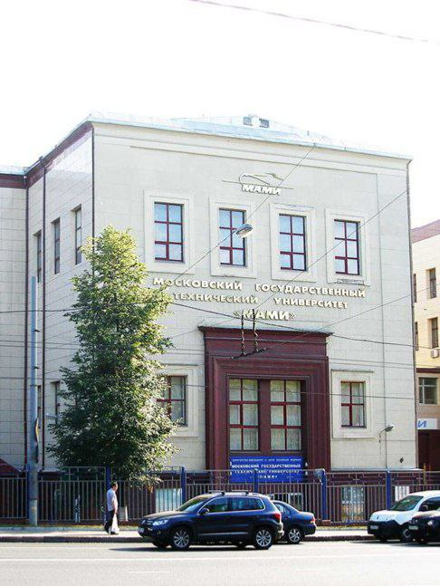
Higher Education
University: Moscow Polytechnic University
Specialty: Web technologies
Key disciplines: Web technologies, digital design.
Graduation date: Expected in July 2028

Slide 4
Work Experience
Was handing out leaflets.
Contributed into the university project.
Helped acquaintances with PC maintenance.

Slide 5

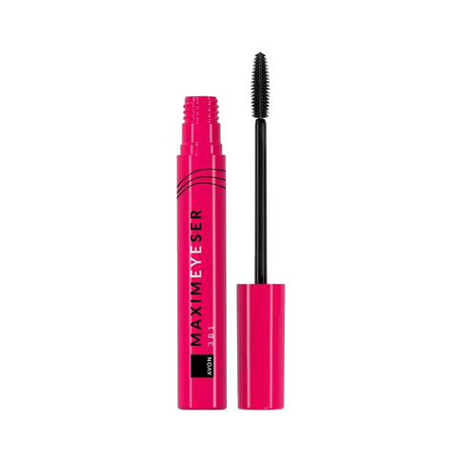
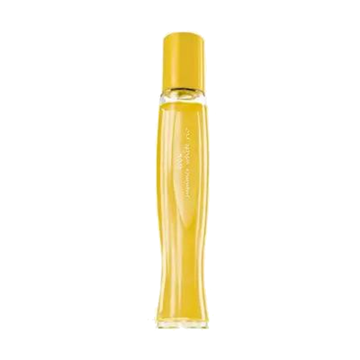
Company commodities
Skin-care products
Cosmetics
Perfume

Slide 6
Assessment of the company
Pros
Variety
Online shopping
Reliable delivery
Affordable prices
Safe and natural components
Cons
Shortened variety
Small number of pickup points
No opportunities to try the product

Slide 7
What’s for me?
Qualities:
Easy-going
Hard-working
A quick study
Attentive

Slide 8
Thank you for attention!
By Romanov Alexander

